Slide 1

BloomQuest
2023-035
Personalized Learning System Based on Knowledge Graphs and Bloom’s Taxonomy.

Slide 2
Research Objectives
Generate a comprehensive mind map for a given study material.
Generate a set of questions and answers from the study material and categorize them according to bloom’s taxonomy.
Track and forecast student performance in a specific subject.
Provide online extra study resources related to the upload study material.
1
Develop a
personalized
self-learning system
to help undergraduate students.
2
3
4

Slide 3
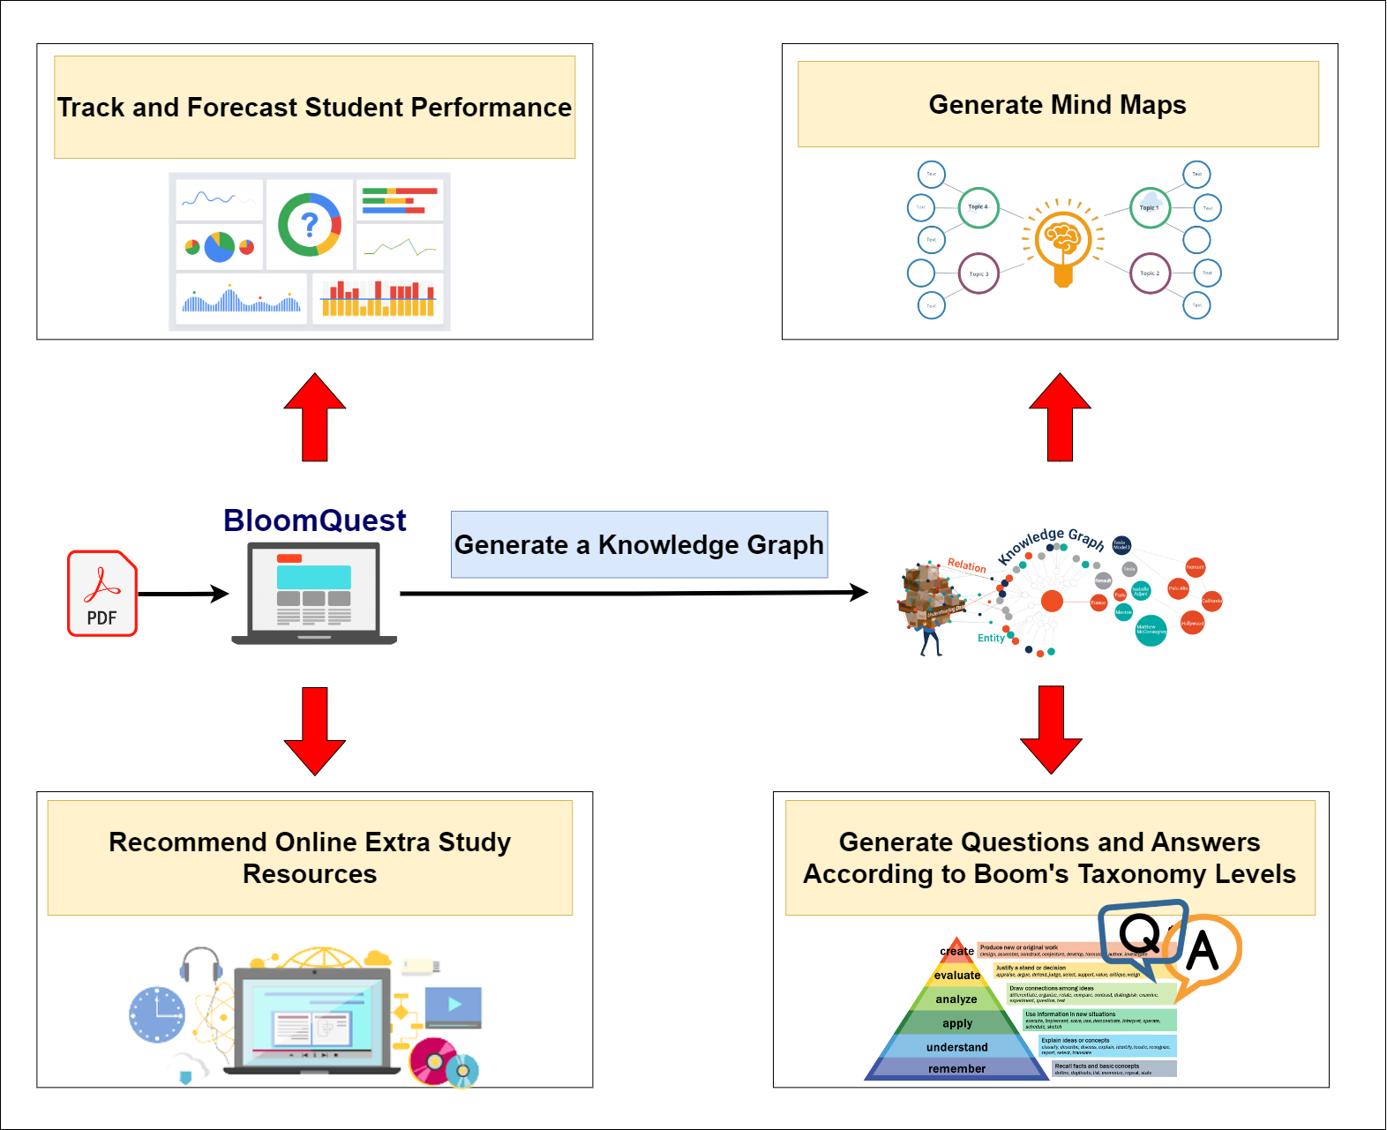
High-Level System Diagram

Slide 4
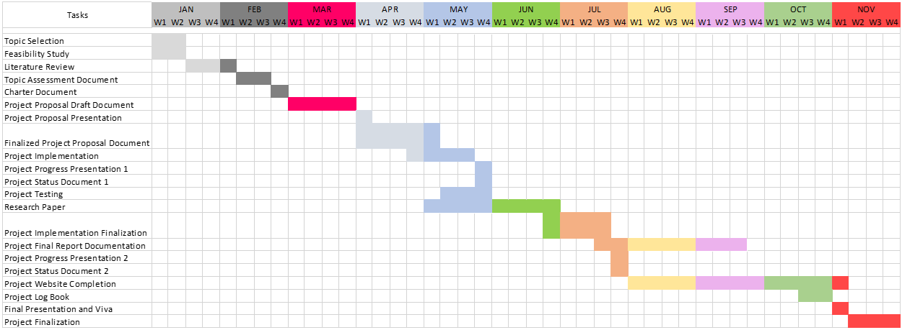
Gantt Chart

Slide 5

IT20133504 | Weerasekara n. n.
Data Science
IT20133504 | Weerasekara N.N. | 2023-035

Slide 6
Background
What is a MIND MAP? - Mind mapping is a technique used for visually organizing information and concepts in a diagram or map. It's a widely-used method for note-taking, brainstorming, and idea organization.
This research attempts to design a knowledge-based system that uses domain-specific knowledge to generate more precise and significant mind maps from text input in order to get over this constraint.
IT20133504 | Weerasekara N.N. | 2023-035

Slide 7
Research Question
"Can a knowledge-based system improve the accuracy and usefulness of mind maps generated from text data compared to existing text mining algorithms and Machine learning approaches?"
IT20133504 | Weerasekara N.N. | 2023-035

Slide 8
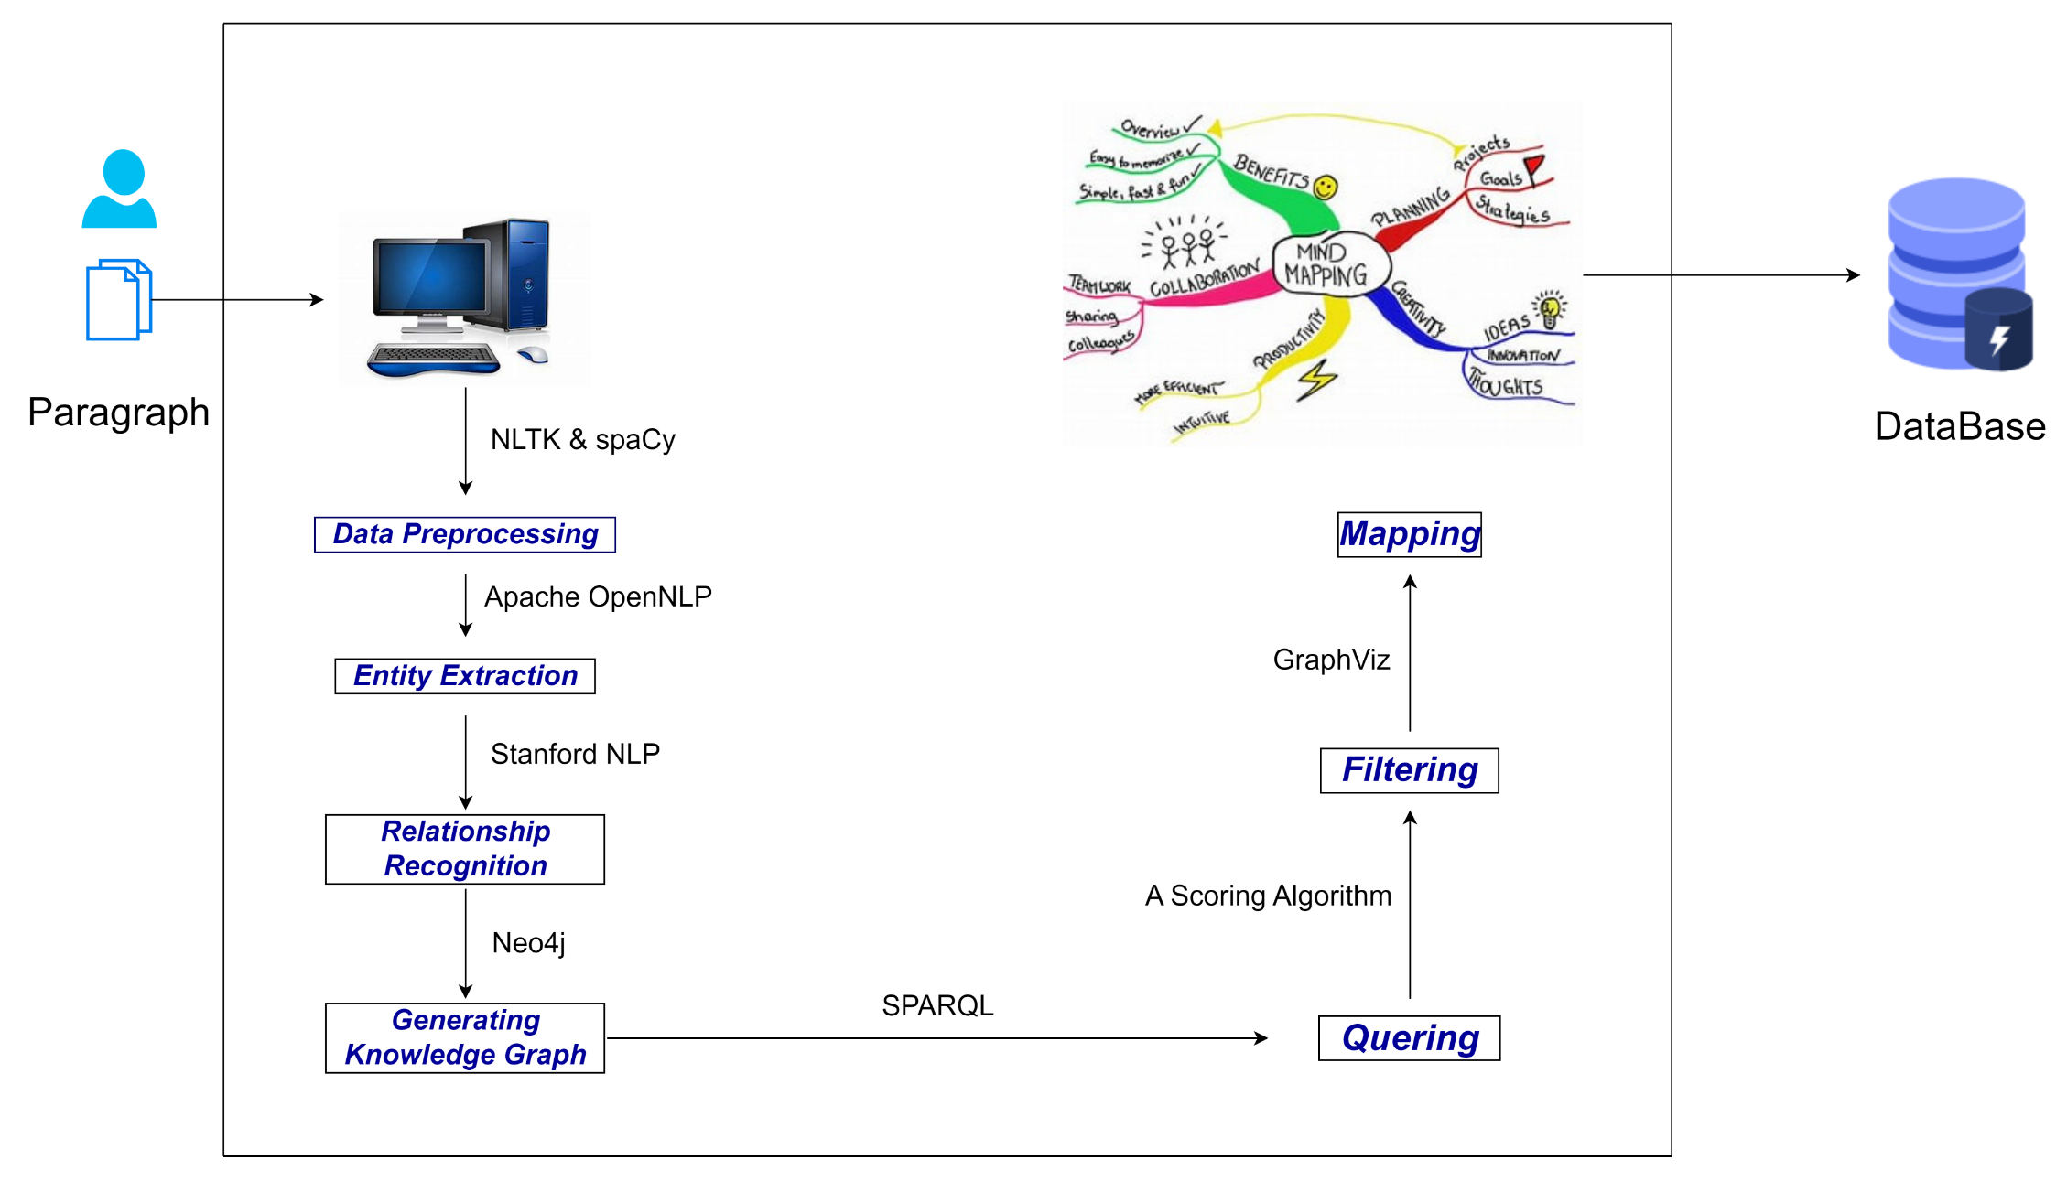
Component Diagram
IT20133504 | Weerasekara N.N. | 2023-035

Slide 9
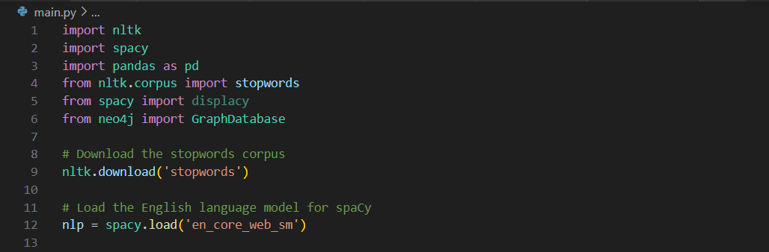
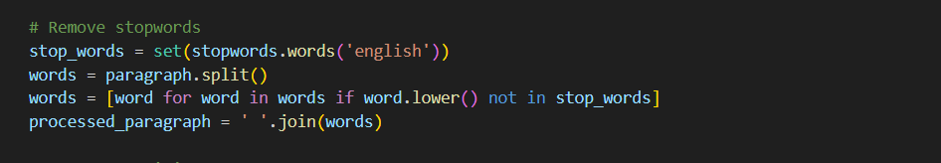
Technologies
Imported Python Libraries.
2. Text Preprocessing : Clean the text data by removing stop words, punctuations, etc.
IT20133504 | Weerasekara N.N. | 2023-035

Slide 10
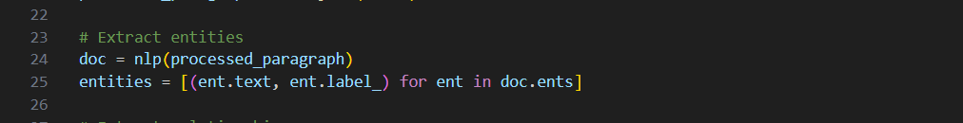
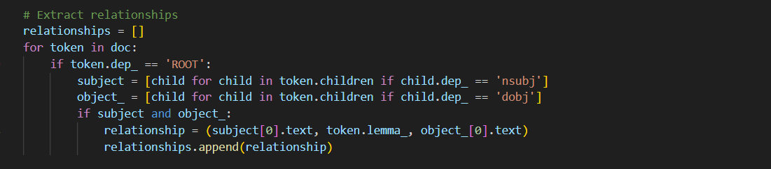
Technologies ctd.
3. Entity Recognition : Identify the name entities. (e.g.- People, Places, etc.)
4. Relationship Extraction : Identify the relationships between the entities.
IT20133504 | Weerasekara N.N. | 2023-035

Slide 11
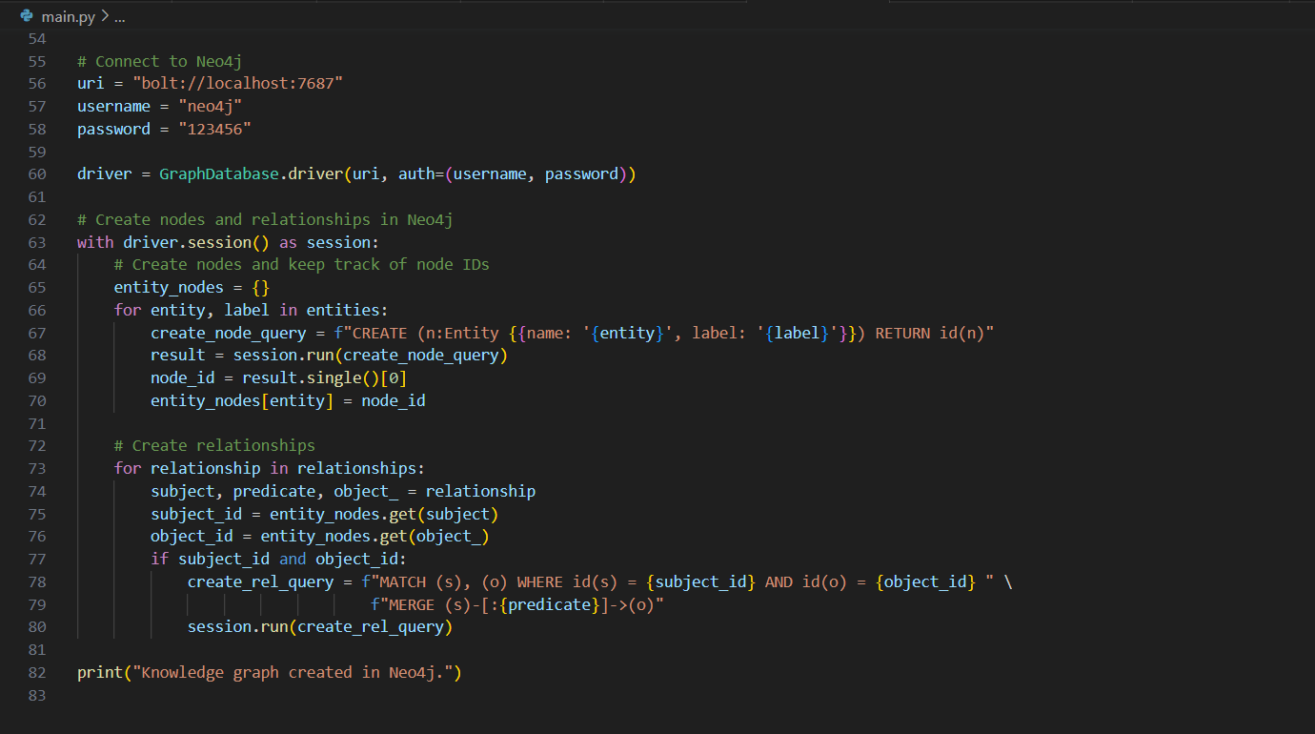
5. Graph Construction : Construct the graph. ( Entities as nodes, Relationships as Edges.)
IT20133504 | Weerasekara N.N. | 2023-035

Slide 12
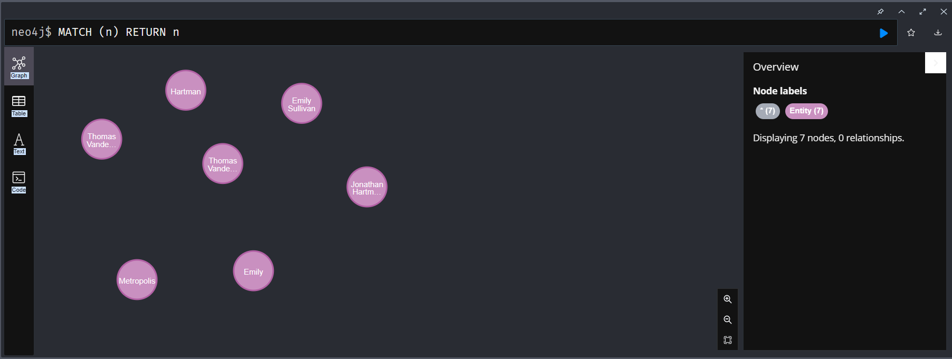
5.1 Graph Construction : Output
2023-07-05
2023-07-05
IT20133504 | Weerasekara N.N. | 2023-035

Slide 13
Current Progress – 50%
Knowledge Graph Development
Preprocess the given paragraph.
Identify the entities from the given paragraph.
Identify the Relationships from the given paragraph.
Developed a basic Knowledge graph.(Entities-Nodes/ Relationships -Edges)
Interface Development
Designed and developed an interface to input a paragraph.
IT20133504 | Weerasekara N.N. | 2023-035

Slide 14
Future Progress – 100%
Develop the Knowledge Graph
Fine tune and add more accuracy to the graph.
Querying
Retrieve data from Knowledge graph.
Filtering
Include only the relevant entities and relationships by using a scoring algorithm.
Mapping
Map the entities and Visualize.
Develop a better interface.
IT20133504 | Weerasekara N.N. | 2023-035

Slide 15

IT20126438 | Colambage K.g
Data Science
IT20126438 | Colambage K.G | 22023-035

Slide 16


Background
What is Generate a set of questions and answers using knowledge graph and categorize them according to bloom’s taxonomy?
Generating a set of questions and answers using a knowledge graph involves extracting information from a structured representation of knowledge and transforming it into a set of questions and answers. Bloom's taxonomy is a framework for categorizing educational goals and objectives into levels of cognitive complexity. Categorizing the questions and answers generated by the knowledge graph according to Bloom's taxonomy involves mapping them to the appropriate level of cognitive complexity, such as remembering, understanding, applying, analyzing, evaluating, or creating. This can help ensure that the questions and answers are appropriate for the level of learning intended and can guide the design of instructional materials and assessments
• Why do we say that it’s useful ?
If you have enough knowledge about Bloom’ taxonomy level, you can handle how to face the questions by categorizing Bloom’ taxonomy level
IT20126438 | Colambage K.G | 22023-035

Slide 17
Research Problem
Proposed Solution
How can generating questions and answers and categorizing them according to Bloom's taxonomy is the limited availability of question generation techniques specifically designed to align with the taxonomy
Develop a question generation framework that explicitly incorporates the cognitive complexity levels defined by Bloom's taxonomy. The framework can utilize natural language processing techniques, machine learning algorithms, and educational domain knowledge to automatically generate questions that align with the desired taxonomy level.
IT20126438 | Colambage K.G | 22023-035

Slide 18
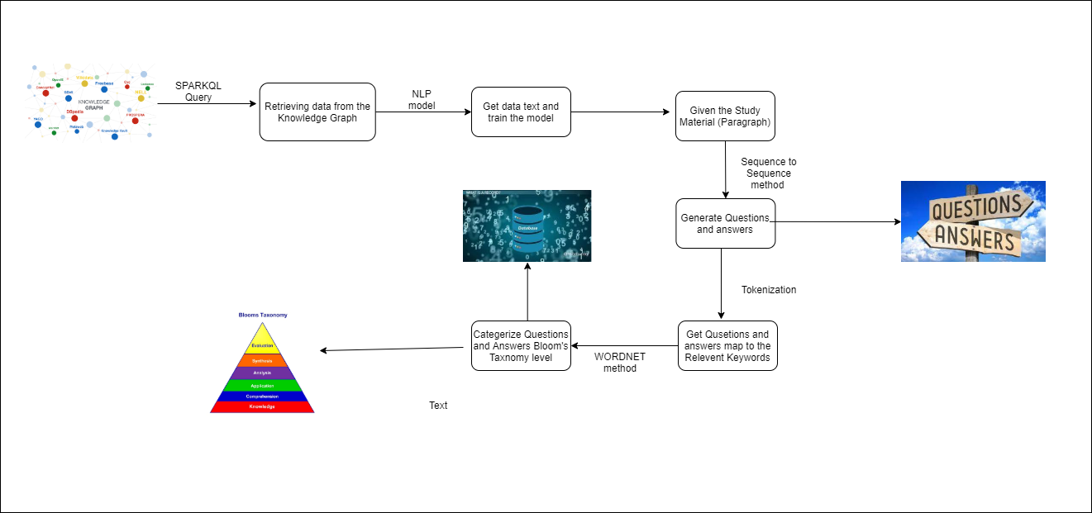
Component Diagram
IT20126438 | Colambage K.G | 22023-035

Slide 19
Current Progress – 50%
Define in the Query
Devided in SPARKQL Query in Knowledge graph.
Development Question and Answers.
Develop the seqence to seqence (seq to seq) Model.
Preprocess the Study material.
Generate Questions and Answers.
Design the Interface.
Development Questions and answers Bloom's taxonomy Levels.
IT20126438 | Colambage K.G | 22023-035

Slide 20
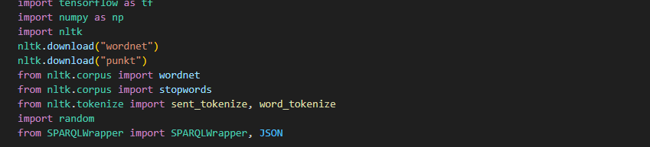
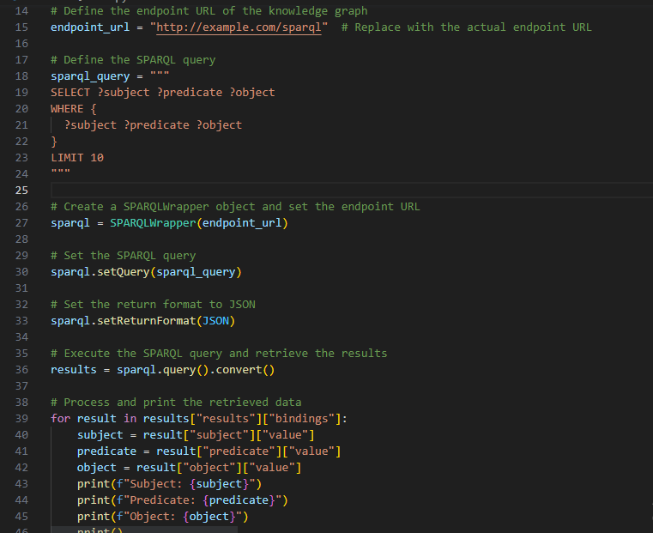
Proof Of Work
Import Python Libraries
2. Devided in SPARKQL Query in Knowledge graph
IT20126438 | Colambage K.G | 22023-035

Slide 21
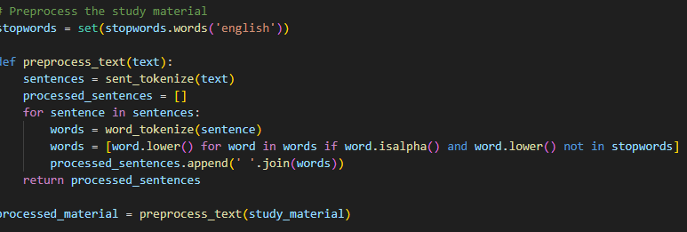
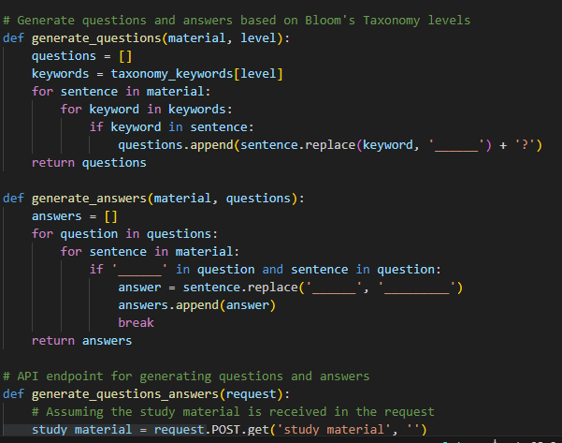
Preprocessing the Study Material
Generate Question and Answers
IT20126438 | Colambage K.G | 22023-035

Slide 22
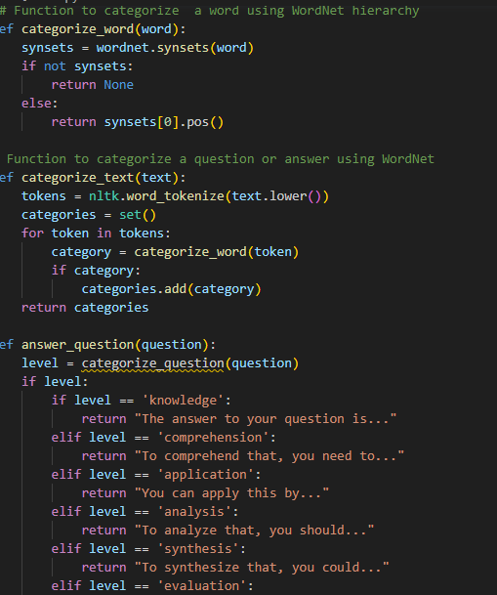
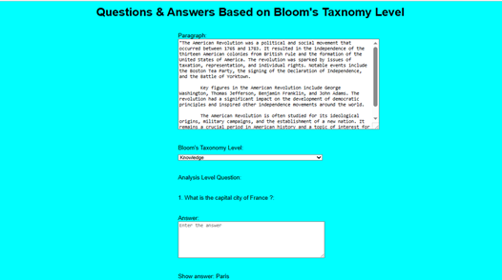
3. Question and answers Categorize Bloom's Taxonomy Level
4. Display the Questions and Answers
IT20126438 | Colambage K.G | 22023-035

Slide 23
Future Progress – 100%
Development Study Material
Preprocessing the Study Material.
Design the Interface
Develop the Categorize Questions and Answers Bloom's Taxonomy Level
Display Questions and answers Bloom's taxonomy level according to the study material.
Display the Bloom's taxonomy levels.
Design the time period to write answers.
Design the grading to given the answers.
IT20126438 | Colambage K.G | 22023-035

Slide 24

IT20123468 | SENAWEERA T.I.S
Software Engineering
IT20123468 | Senaweera T.I.S. | 2023-035

Slide 25
Research Problem
Proposed Solution
Develop a performance Index combing platform-based metrics and Bloom’s Taxonomy metrics.
Train a time-series forecasting model to predict accurate future performance.
How to help and motivate students in self-studies by tracking their current performance and forecasting future performance?
IT20123468 | Senaweera T.I.S. | 2023-035

Slide 26
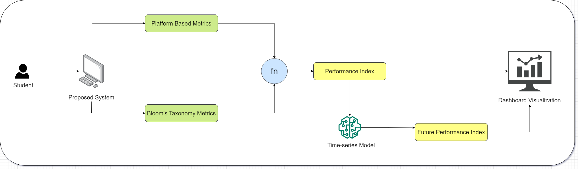
Component Diagram
IT20123468 | Senaweera T.I.S. | 2023-035

Slide 27
Current Progress – 50%
Performance Index Development
Identified the platform metrics.
Identified bloom’s taxonomy levels.
Assigned weights to platform metrics and bloom’s taxonomy levels.
Developed the basic equation to calculate the performance index.
Dashboard Development
Designed and developed a dashboard to visualize performance data.
Forecast Future Performance
Trained LSTSM and bidirectional LSTM models.
IT20123468 | Senaweera T.I.S. | 2023-035

Slide 28
Performance Index
Platform Based Metrics
1. Average Active Time Per Day.
2. Average Number of Quizzes Completed Per Day.
3. Average Time Taken to Answer a Question in a Quiz.
Bloom’s Taxonomy Metrics
1. L1 – Remembering and Understanding.
2. L2 – Applying.
3. L3 – Analyzing, Evaluating and Creating.
IT20123468 | Senaweera T.I.S. | 2023-035

Slide 29
Basic Equation
Performance Index = [(0.3L1 + 0.4L2 + 0.3L3) + (100 / 3)(X1 + X2 + X3)] / 2
L1 – EWMA Value of Bloom’s Level 1
L2 – EWMA Value of Bloom’s Level 2
L3 – EWMA Value of Bloom’s Level 3
X1 – Normalized Average Active Time Per Day
X2 – Average Number of Quizzes Completed Per Day
X3 – Normalized Average Time Taken to Answer a Question in a Quiz
IT20123468 | Senaweera T.I.S. | 2023-035

Slide 30
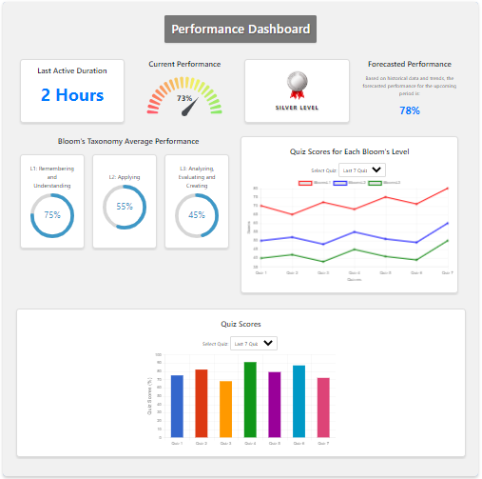
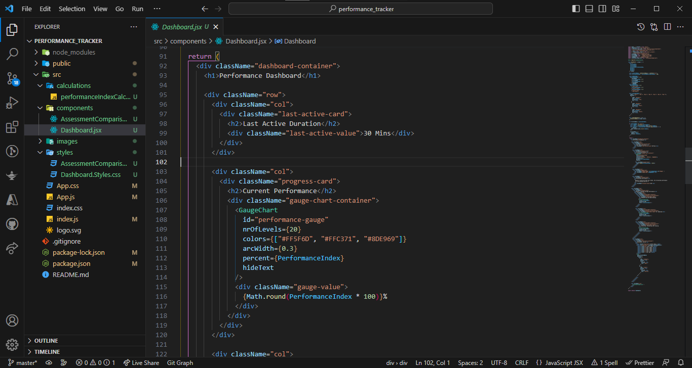
Proof of Work
Dashboard
IT20123468 | Senaweera T.I.S. | 2023-035

Slide 31
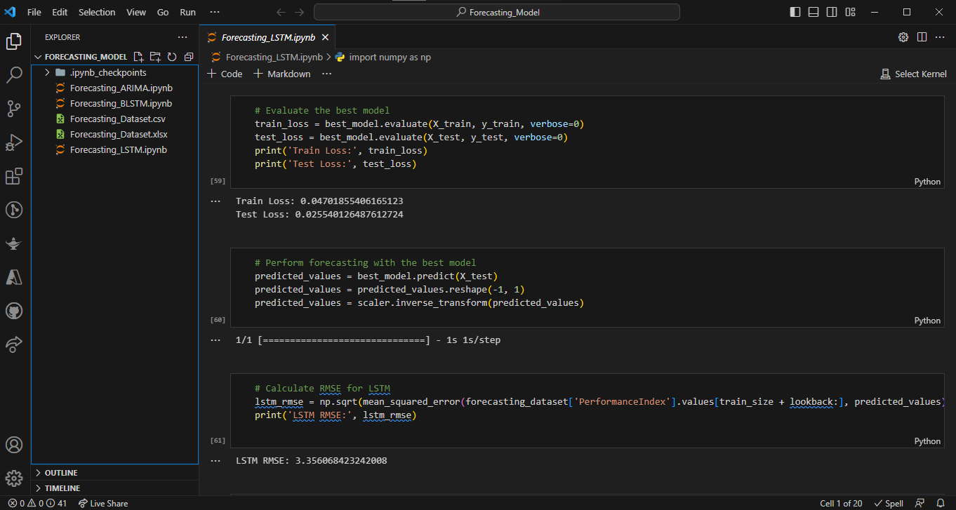
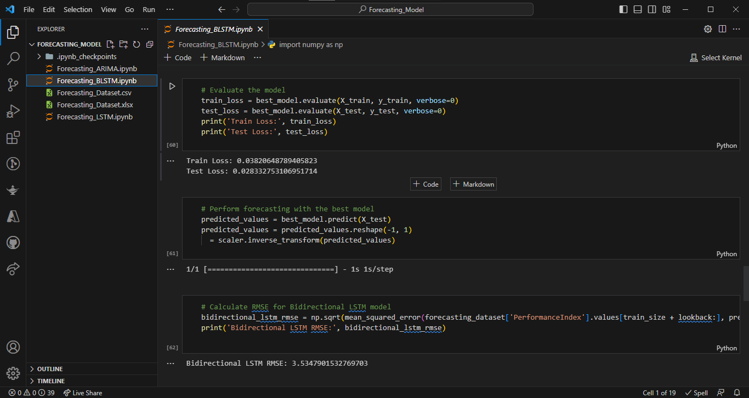
Proof of Work
LSTM Model Training
Bidirectional - LSTM Model Training
IT20123468 | Senaweera T.I.S. | 2023-035

Slide 32
Future Progress – 100%
Performance Index Development
Fine tune the equation.
Validate equation using a real-world dataset.
Dashboard Development
Add more components.
Enhance visualization and attractiveness.
Forecast Future Performance
Train the best model with the real-world dataset to predict accurate future performance.
IT20123468 | Senaweera T.I.S. | 2023-035

Slide 33

IT20133368 | Wijayasena w.d.n.d.t
Data Science
IT20133368 | Wijayasena W.D.N.D.T. | 2023-035

Slide 34
Research Problem
Proposed Solution
Develop a system that provides personalized recommendations of highly relevant and popular extra resources based on the student's uploaded study material.
How can the declining interest of students in seeking and engaging with recommended extra resources during university lectures be addressed effectively?
IT20133368 | Wijayasena W.D.N.D.T. | 2023-035

Slide 35
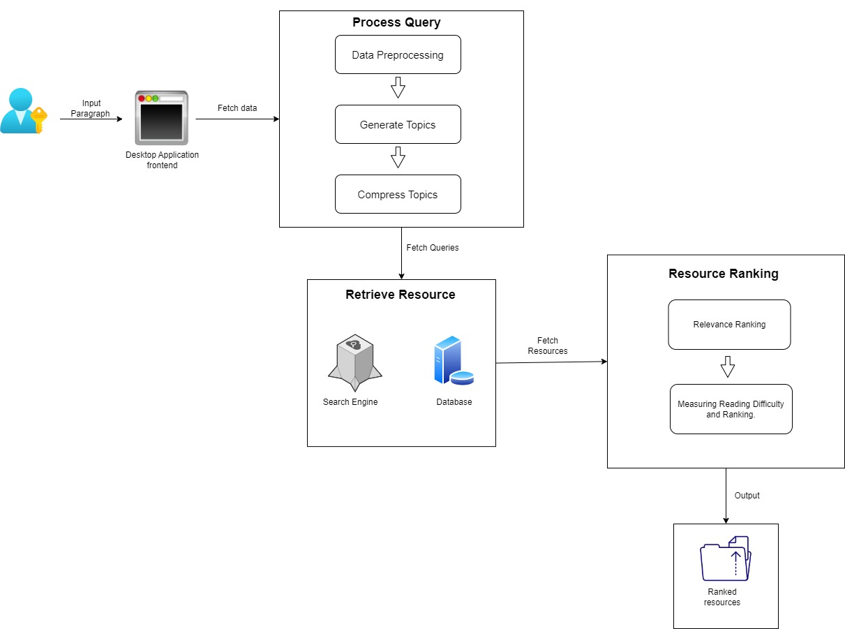
System Diagram
IT20133368 | Wijayasena W.D.N.D.T. | 2023-035

Slide 36
Current Progress – 50%
Process Query
Implement the process of pre-processing the given paragraph.
Develop the Latent Dirichlet allocation (LDA) Model.
Compress the topics to avoid topic duplication.
Retrieve Resources.
Retrieve relevant resources from google.
Display resources.
IT20133368 | Wijayasena W.D.N.D.T. | 2023-035

Slide 37
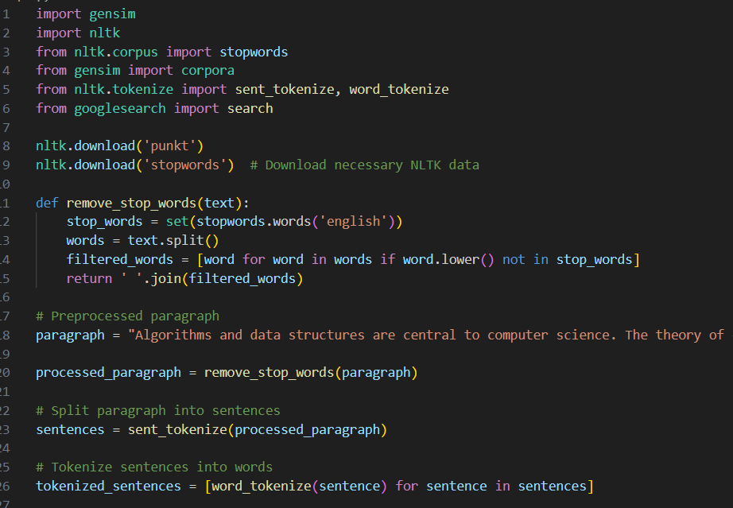
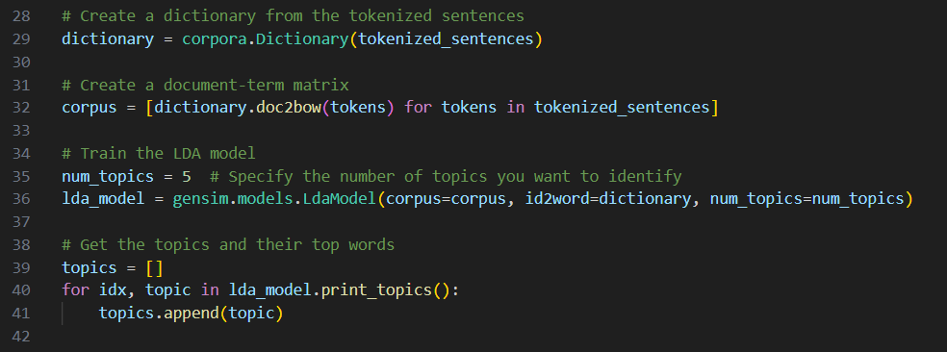
Proof of Work
Implement LDA model
Pre-process Passage
IT20133368 | Wijayasena W.D.N.D.T. | 2023-035

Slide 38
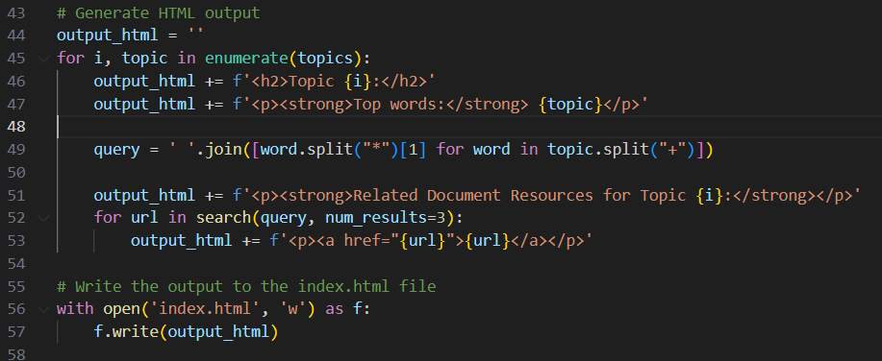
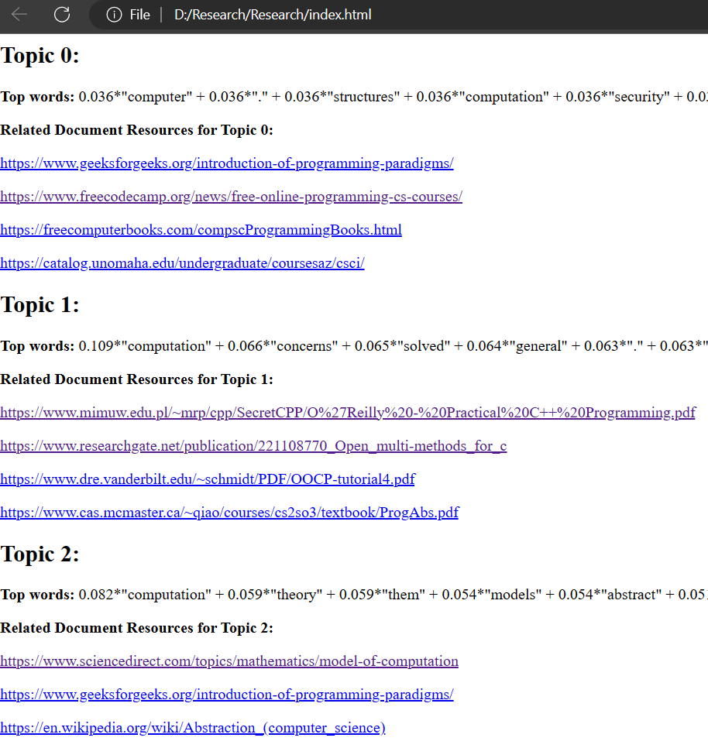
Proof of Work
Retrieve Resource
Display Retrieve Resource
IT20133368 | Wijayasena W.D.N.D.T. | 2023-035

Slide 39
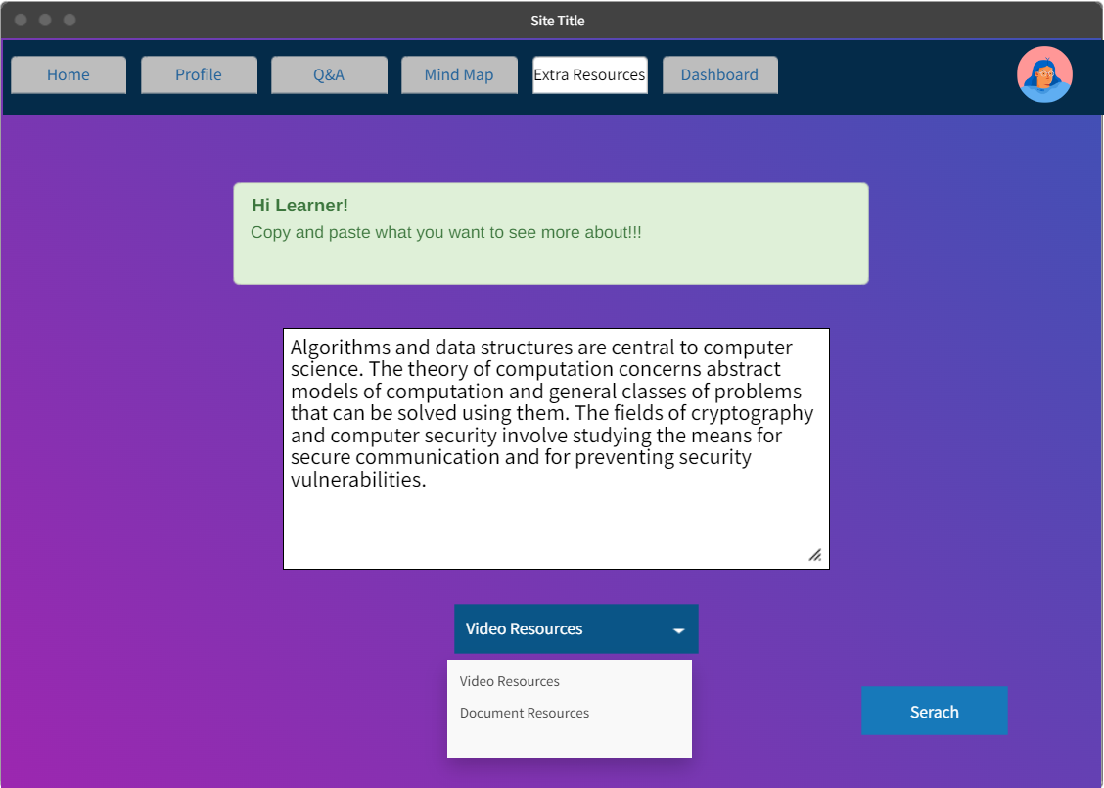
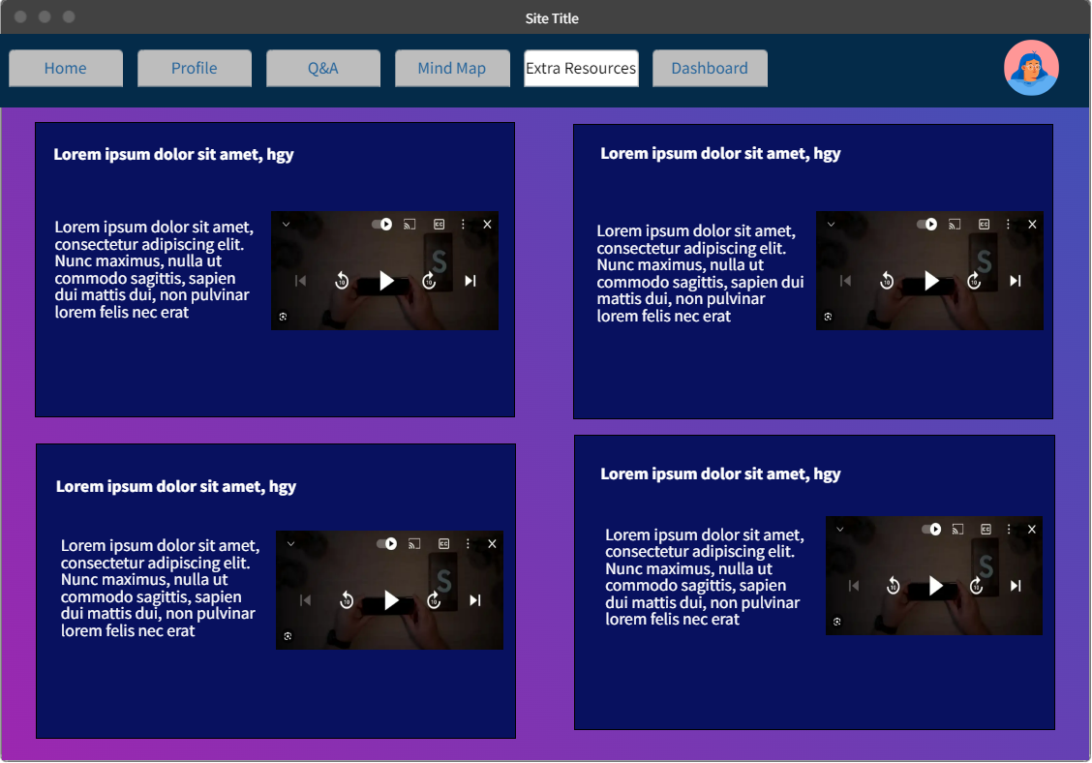
UI Wireframes
IT20133368 | Wijayasena W.D.N.D.T. | 2023-035

Slide 40
Future Progress – 100%
Rank the resources based on relevance ranking.
Rank the resources based on the reading difficulty.
Create and equation to merge above ranking levels together.
Display best resources.
IT20133368 | Wijayasena W.D.N.D.T. | 2023-035

Slide 41

Thank you
IT20133368 | Wijayasena W.D.N.D.T. | 2023-035

